Slide 1
DISC personality testing

Slide 2
DISC Model
Foundation comes from Harvard psychologist Dr. William Moulton Marston and his work in the 1920’s
He developed a theory that people tend to develop a “self-concept” based on one of FOUR factors
DOMINANCE
INDUCEMENT
STEADINESS
COMPLIANCE

Slide 3
Based on “Normal” Behaviors
To pictorially illustrate the DISC model, we represent the range of normal human behaviors and perspectives as a CIRCLE
“Normal human behaviors” means behaviors and perspectives derived from mainstream, healthy psychology
To effectively use the DISC model though remember NOTHING in the DISC model describes or discusses any type of psychosis, mental illness, or psychological abnormality

Slide 4
Drives
DISC model is based on how we react to two defining MOTIVATORS which tend to drive behaviors
Motor Drive
The “Pace” Drive
Compass Drive
The “Priority” Drive

Slide 5
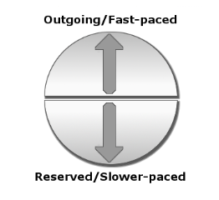
Motor Drive (Pace Drive)
The Upper Half represents outgoing or fast-paced people
People here tend to: move fast, talk fast, and decide fast
The Lower Half represents reserved or slower-paced people
People here tend to: speak more slowly and softly, prefer to consider things carefully and thoroughly
REMINDER: THESE DESCRIPTIONS ARE tendencies NOT absolutes

Slide 6
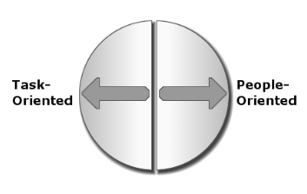
Compass Drive (Priority Drive)
The Left Half represents task-oriented people
People here tend to: focus on logic, data, results, and projects
The Right Half represents people-oriented people
People here tend to: focus on experiences, feelings, relationships, and interactions with people
REMINDER: THESE DESCRIPTIONS ARE tendencies NOT absolutes

Slide 7
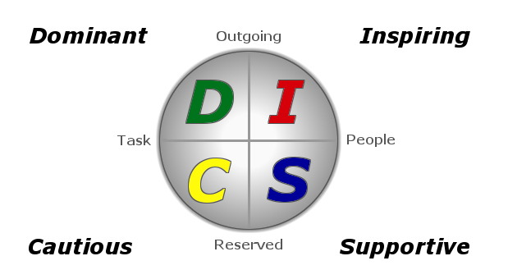
Four Basic DISC Styles/Types
About 80% of people have two “high” DISC types
One is most likely higher than the other and is your PRIMARY style with the second one INFLUENCING the primary style
C/D means C is PRIMARY and D is INFLUENCING
5% have only 1 “high” DISC type
15% have TWO secondary types that influence their primary style

Slide 8
DOMINANT
People who have both OUTGOING and TASK-ORIENTED traits often exhibit dominant and direct behaviors
They usually focus on results, problem-solving, and the bottom-line

Slide 9
INSPIRING
People who have both OUTGOING and PEOPLE-ORIENTED traits often exhibit inspiring and interactive behaviors
They usually focus on interacting with people, having fun, and/or creating excitement

Slide 10
SUPPORTIVE
People who have both RESERVED and PEOPLE-ORIENTED traits often exhibit supportive and steady behaviors
They usually focus on preserving relationships and on creating or maintaining peace and harmony

Slide 11
CAUTIOUS
People who have both RESERVED and TASK-ORIENTED traits often exhibit cautious and careful behaviors
They usually focus on facts, rules, and correctness

Slide 12
