Slide 1
A very brief introduction to your Brain and Mindfulness
Resources: www.mindfulteachers.org

Slide 2
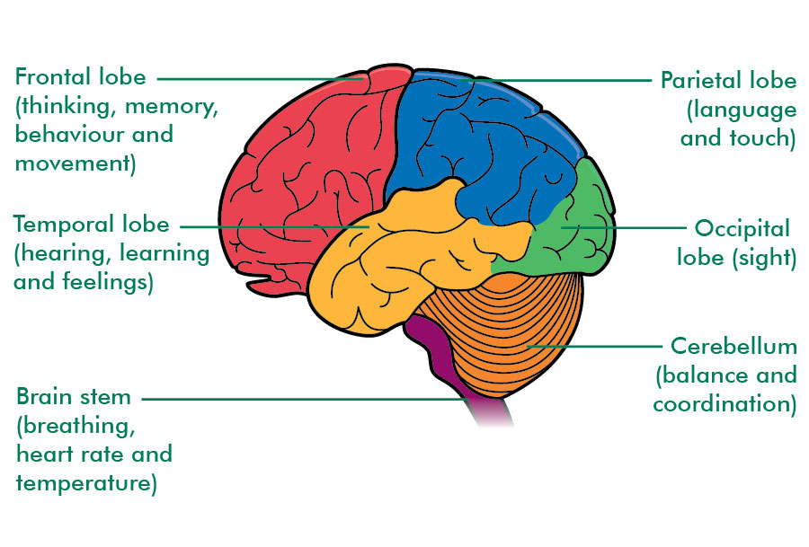
Major Parts of the Brain
The largest part of the brain, the forebrain, includes the cerebrum which has four main sections:
Parietal Lobe—helps us know where we are by understanding our physical self, our location in space, and how we move
Temporal Lobe—helps with our five senses, memory, and use of language
Frontal Lobe—helps us pay attention, regulate emotions, and problem solve
Occipital Lobe—helps us to see what’s around us

Slide 3
Major Parts of the Brain
The base of the brain, the hindbrain, includes the:
Brain stem which connects to the spinal cord and is responsible for keeping you alive and performing many of the functions we don’t even think about (like keeping our heart beating)
Limbic System which includes the amygdalae which operate like an alarm system. Useful when there’s an emergency but not helpful if it is alarming all the time

Slide 4
Mindfulness to Keep us Present and Reduce Stress
Mindfulness—is attention and intention
Attention or focus
Intention or purpose
Whatever is happening or you’re feeling or someone’s saying…you’re aware of it
Am I focusing on what’s actually happening or on what I want or don’t want to happen
It can be a real challenge to keep our attention focused where we want it to be
Sometimes that amygdalae goes off and keeps going off…even if we are not in danger

Slide 5
Ways to Practice Mindfulness
Formal | Informal
Setting aside a certain period of time every day just to be present | Paying full attention to whatever is happening right now in this moment
Mindfulness can help to reduce stress. Oftentimes our stress comes from us focusing not on what is but what could be which causes us to imagine different scenarios and make predictions that can lead to our minds spiraling out of control. Being Mindful keeps us in the present moment, thinking about the things that are actually happening and that are therefore in our control. Doing this can help reduce stress

Slide 6
Trying it out…
VISUALIZING STRESS
Take a moment to visualize what stress looks and feels like inside your body
Now that you have visualized it, try to release it from your body
NOISE ISOLATION
We hear a variety of sounds in this classroom (students walking in the hallway, the PE classes, our peers shifting in their seats).
Take a moment and focus on one noise
Describe that noise fully to yourself and try and recall the last time you interacted with it

Slide 7
Gratitude
What is gratitude?
Recognizing and appreciating what is good in our lives and being thankful for those things
Mindfulness helps us pause our busy lives and notice what we have and should be grateful for
These do not have to be major things, they can be something as minor as a beautiful sunny day
Let’s spend 5 minutes right now and start a Mindfulness/Gratitude Journal
HW: Spend 5 minutes every day for the next 3 days on a Mindfulness/Gratitude Journal

